Slide 1
The Relevance of iSHARE2 & Center-in-a-Box (CiB) for an
INDEPTH Member Centre
Kobus Herbst
iSHARE2 Support Team

Slide 2
Introduction
INDEPTH Membership requirement to submit basic demographic indicators on an annual basis
Emerging requirement to submit core micro data underlying the basic demographic requirements
INDEPTH Data Access & Sharing policy requires sharing of core micro data

Slide 3
What is iSHARE2?
An initiative to assist INDEPTH members to:
  Efficiently provide standardised, high quality information
Supported by:
  Published micro data standard format
  Standardised methods to derive demographic indicators from the micro data set
iSHARE2 support the efficient production of the micro data in a standard way

Slide 4
iSHARE2 Objectives
Assist INDEPTH Scientific Working Groups and Network scientific activities to extract data from the operational databases of member centres
Lead an expansion in INDEPTH data sharing by making available the micro datasets produced by Network scientific activities on a publicly accessible, web-hosted INDEPTH repository
Strengthen and maintain the skills, procedures and infrastructure to assure quality and share longitudinal datasets of public health importance
Building of data management capacity for the Network by providing course content and placements for students and trainees in research data management.

Slide 5
Approach
Curate Core Network Microdata
Network Scientists
Facilitate Working Group Data Mx
HDSS Data Collection
INDEPTH Network Data Repository
Scientific Output
Improve Research Data Mx
Publication Data Curation
Broader User Base
Data Standardisation & Documentation
Data Repository
Centre-in-a-Box

Slide 6

Centre-in-a-Box
Database Server
Data-Manager Desktop
Web Server, Data Repository
(NADA),
File Manager
System Admin-istration
ETL
Publisher
R
Remote Support & Help Desk

Slide 7
CiB Significance
Standard Operating and Software Environment
  Only Database System varies between Centres
  Standard, quality-controlled procedures to extract, analyse and present network data sets
Portable Hardware
  Can be used by any data analysis workshop
  Consistent and easy preparation for joint analysis
Incorporate CiB training in Research Data Management MSc
  Build sustainable capacity in Network

Slide 8
Database Server
Not intended to replace operational/production database server
Analytical Snapshot
Data Collection Round
Operational Database
Extraction
Transformation
Loading
Documentation
Analytical Snapshot
Data Collection Round
Data Collection Round
Analytical Snapshot

Slide 9
Data Manager Desktop
Standard Environment where we can support a data manager
Standard and supported set of tools
Freely available toolset – no monetary barriers

Slide 10
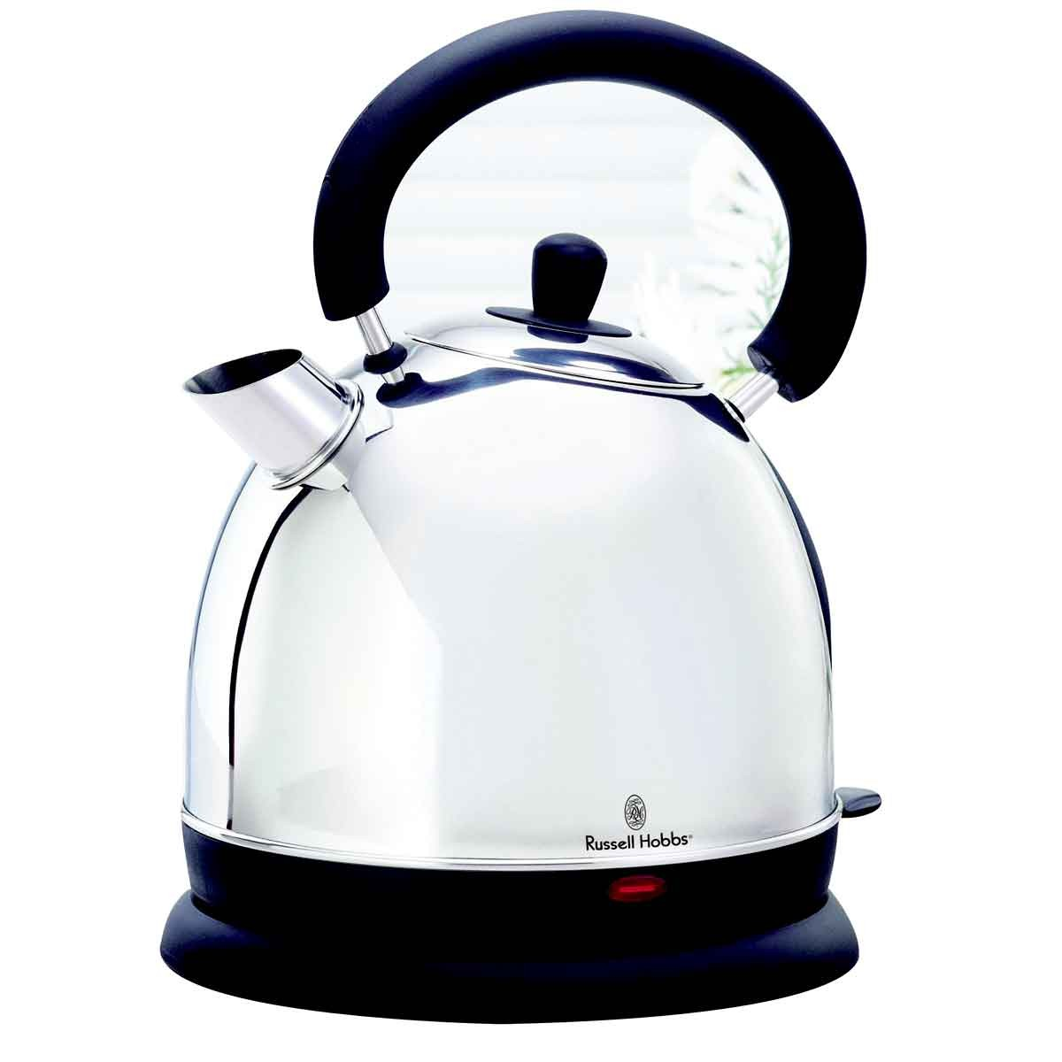
ETL – Pentaho Kettle
Powerful extraction, transformation and loading tool
Support data in a wide variety of input formats
Can output data in a wide variety of formats
Can manipulate data in various ways
Research data management can be automated and standardised
Standard data manipulation recipes can be shared

Slide 11
Nesstar Publisher
Data documentation
Freely available standard tool
DDI – international standard
Analytical data sets become a digital product:
  Uniquely identified
  Retrievable
  Citable
  Acknowledgement

Slide 12
NADA Repository
Wider community of data users
Centre Scientist & Collaborators
CiB NADA
INDEPTH Network Repository

Slide 13
Study Views
Epidemiology and Treatment of Epilepsy in sub-Saharan Africa | 10178
Nairobi Urban Health and Demographic Surveillance System 2002-2010 | 7378
Vadu INDEPTH Core Dataset 2009-2010 | 6837
Africa Centre INDEPTH Core Dataset 2000-2011 (Residents only) | 5982
Magu Household Demographic Surveillance System Dataset 1994 - 2010 | 5791
Agincourt INDEPTH Core Dataset 1992-2010 | 4951
Chililab Surveillance Dataset 2004-2010 | 3651

Slide 14
Study Downloads
Centre | Downloads
Africa Centre INDEPTH Core Dataset 2000-2011 (Residents only) | 22
Agincourt INDEPTH Core Dataset 1992-2010 | 31
Chililab Surveillance Dataset 2004-2010 | 16
Epidemiology and Treatment of Epilepsy in sub-Saharan Africa | 1
Magu Household Demographic Surveillance System Dataset 1994 - 2010 | 23
Nairobi Urban Health and Demographic Surveillance System 2002-2010 | 124
Vadu INDEPTH Core Dataset 2009-2010 | 55
Grand Total | 272

Slide 15
Who are downloading?
32
30
68
42
2
95

Slide 16
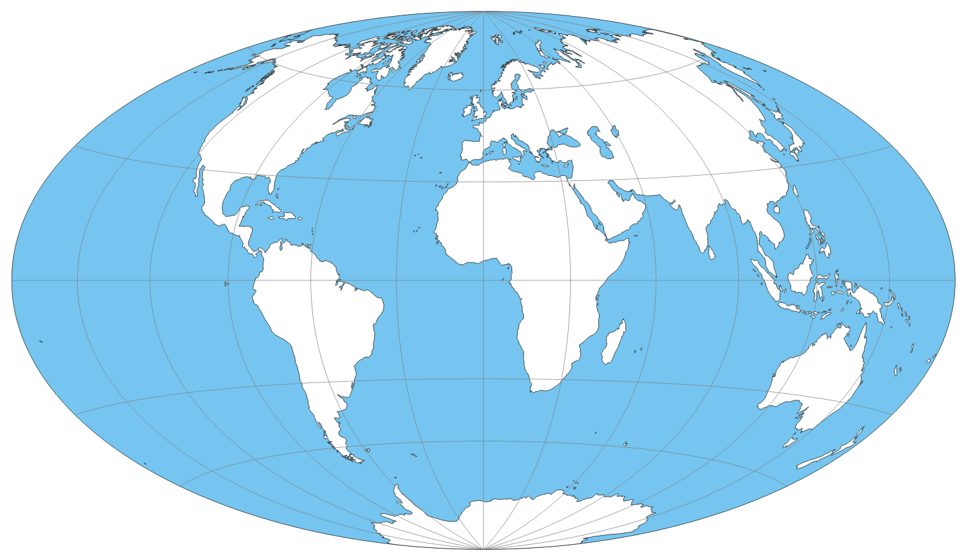
System Admin Desktop
help-ishare2@indepth-network.org

Slide 17


