Slide 1

The INDEPTH Network
www.indepth-network.org
Please use the slides as you deem fit…
Notes:
1

Slide 2
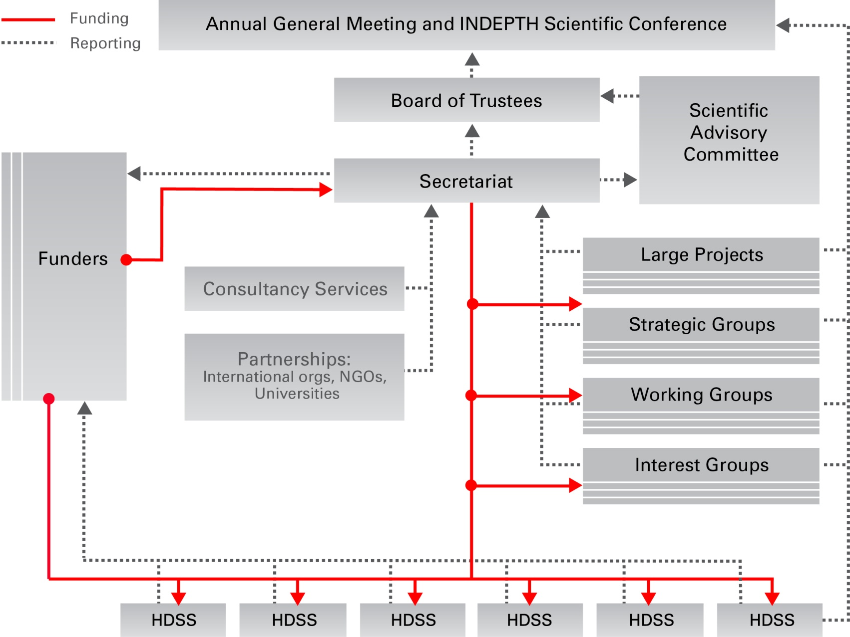

INDEPTH Governance Structure
Notes:
A transparent and accountable governance structure; Board elections; Marcel steps down in Kampala. All the components contribute to an effective and efficiently run organisation

Slide 3
Governance & M&E
  INDEPTH Board meetings
    regular newsletters to the Board
  INDEPTH-Funder teleconferences; visits by funders
  INDEPTH audit by KPMG (previously PWC)
  Weekly newsletters to Centre Leaders
  Quarterly newsletters to the INDEPTH family
Notes:
3

Slide 4
INDEPTH Membership & Effectiveness
  43 member institutions running 49 HDSS field sites
  32/49 HDSSs on INDEPTHStats
  26/49 HDSSs on INDEPTH Data Repository; 10 potentials
  6/49 on the new OpenHDS; 15 in preparation
Notes:
4

Slide 5
Expanding Footprint of HDSS
Notes:
Give a picture of how, because of INDEPTH, HDSS work has grown over the years

Slide 6
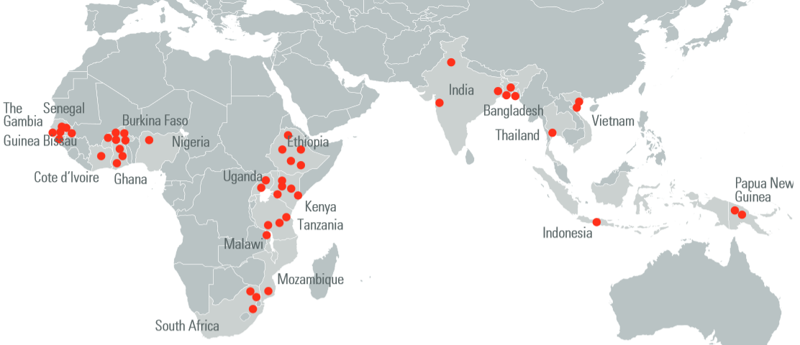
INDEPTH Member HDSS Sentinel Surveillance Countries
Over 3,800,000 people under continuous surveillance in INDEPTH Network
Ethiopia
Uganda
Kenya
Tanzania
Malawi
Mozambique
South Africa
INDEPTH Resource
Centre, Accra
Senegal
The Gambia
Guinea-Bissau
Burkina Faso
Ghana
Nigeria
India
Bangladesh
Thailand
Vietnam
Indonesia
PNG
Through INDEPTH to diverse countries and continents
Notes:
6

Slide 7
















Health and Demographic Surveillance System
HDSS equation for the denominator
7
Verbal Autopsy on all deaths
SAC: 1. WHO 2016
2. Annual VA operation
Out-migrate after 6 months
Exit
Dynamic Cohort
Initial Census
(Unique ID given)
(Rural/Urban/
Peri-Urban)
Ideal cycles of enumeration
2-4/year
SAC: a key concept
Enter
In-migrate after 6 months
Follow up of pregnancies and their outcomes
Notes:
We will need to include HOSPITALS...

Slide 8
Population Data Structure – HDSS Participants
Individual
Date of Birth
Place of Birth
Sex
Parents
Source of income
Measurements
Unique ID given
VISITS
Membership
Residence
Membership
Health Facilities
Household
Dwelling
Residence
Headship
Members
Income
Type
GPS location
Owner
Measurements
Measurements
Notes:
We will include HEALTH FACILITIES

Slide 9
Outputs from an HDSS / CHESS
9
  ADDITIONAL
  population characteristics
  household characteristics, assets and wealth indexing
  health status / disease burdens
  access, use and impact of health services
  health seeking behaviours for severe and fatal conditions
  environmental contexts, risks, exposures
  household food security
  impact of poverty reduction strategies
  impact of health interventions
  CORE
  All cause mortality rates
  Cause-specific mortality proportions & rates
  Life table probabilities
  Fertility rates
  Migration rates
Notes:
Then we can get morbidity...

Slide 10
Strategic Groups
Data Analysis
Capacity Strengthening
Research to Policy
Data Systems
Migration, urbanisation & health

Slide 11
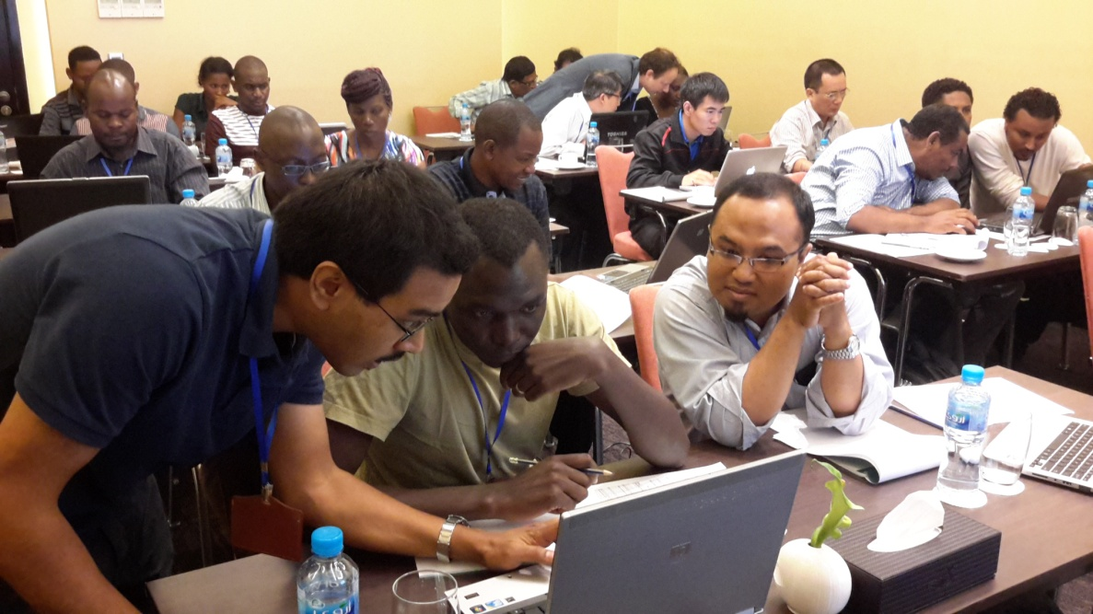
The Working Groups that were effective
Adult health & aging
  NIH grant
Fertility
  EVIDENCE
Vaccination & child survival
  EC/DANIDA grant
Antibiotics resistance
  Wellcome Trust grant
Malaria
  INESS – Gates Foundation grant
  6. Environment & health
    Submitted applications
  7. Health Systems
    iHOPE – Gates Foundation grant
  8. Maternal & Newborn Health
    ENAP – CIFF/LSHTM grant
  9. Education
    Submitted an application
  10. Genomics
    AWI-Gen: NIA grant
Notes:
The working group strategy... It works! Large projects can be generated. Sustainability of INDEPTH

Slide 12
Grant proposal development
20 proposals submitted
13 thematic areas
11 funders
Total amount - $71,333,516 (at least 20% to core)
4 led by the Secretariat

Slide 13
Secretariat led proposals
1) Malaria: treatment, testing & tracking
Comic Relief & GSK; £822,801; 2017-2019 (Funded, April 2017)
2) INESS on CHESS
EDCTP; €3,000,000; 60 months (awaiting news)
3) Conduct rigorous post-licensure effectiveness and safety studies on Pyramax and other interventions against malaria
The Gates Foundation; $1,182,415; 2017 (successful)
4) How do accountability processes within education systems enable or inhibit the raising of learning outcomes – Ghana and Zimbabwe?
ESRC UK; £689,612; 2018-2020 (awaiting news)

Slide 14
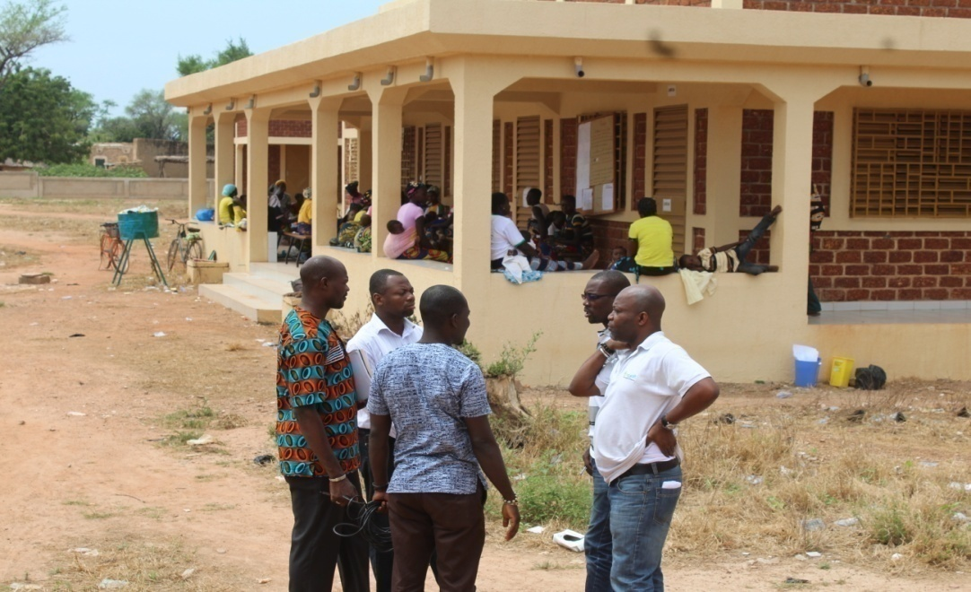
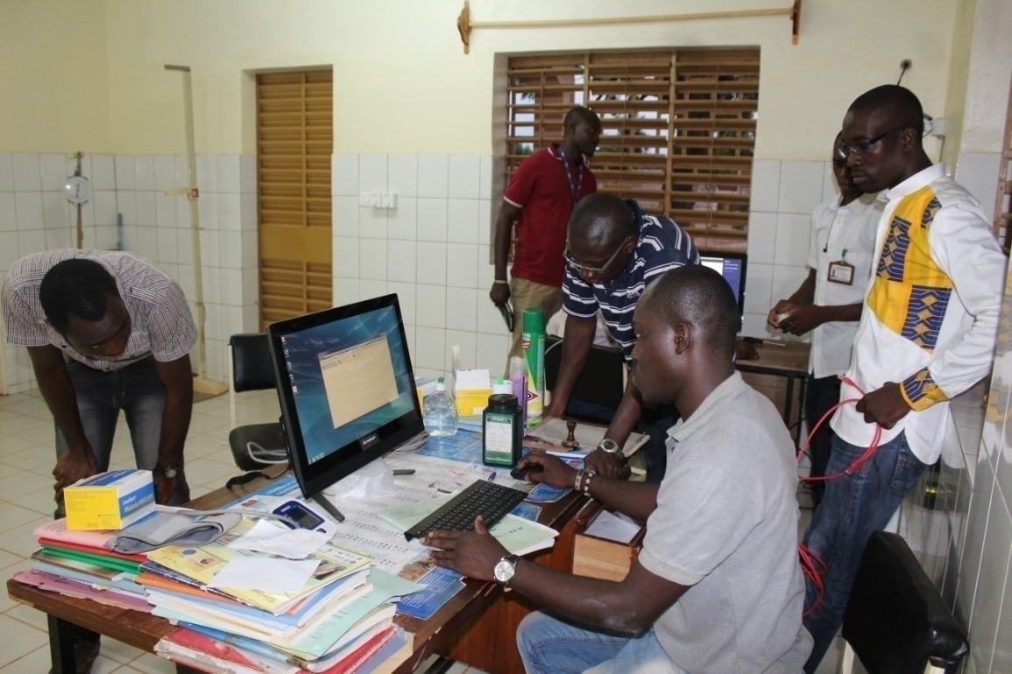
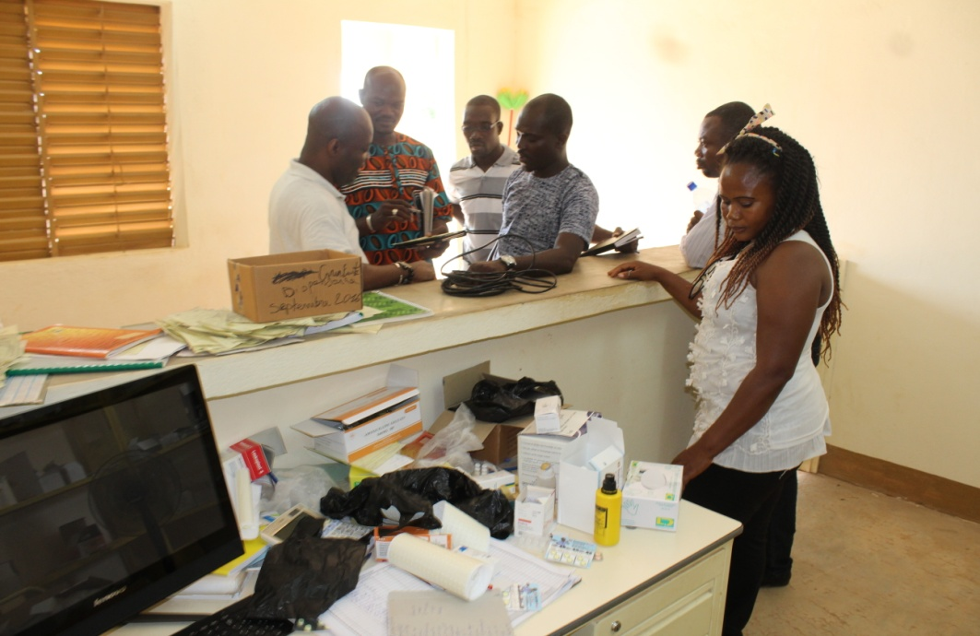
CHESS = HDSS+
HDSS Core: all-cause & cause-specific mortality
HDSS+ (comprehensive package – expands HDSS)
Communicable (disease & pathogen specific) morbidity
Non communicable disease morbidity
External causes / injuries morbidity
Risk factors for above mortality & morbidity
Health systems & policies contexts
Other contexts - e.g. education
SAC: A transformational agenda

Slide 15
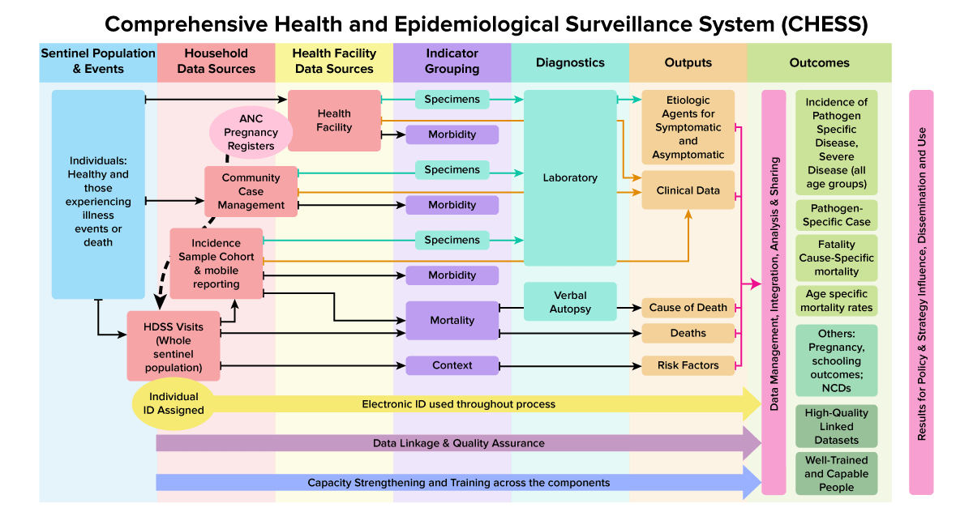
Crystalisation phase funded by Sida
Notes:
What we want o do in the future...

Slide 16
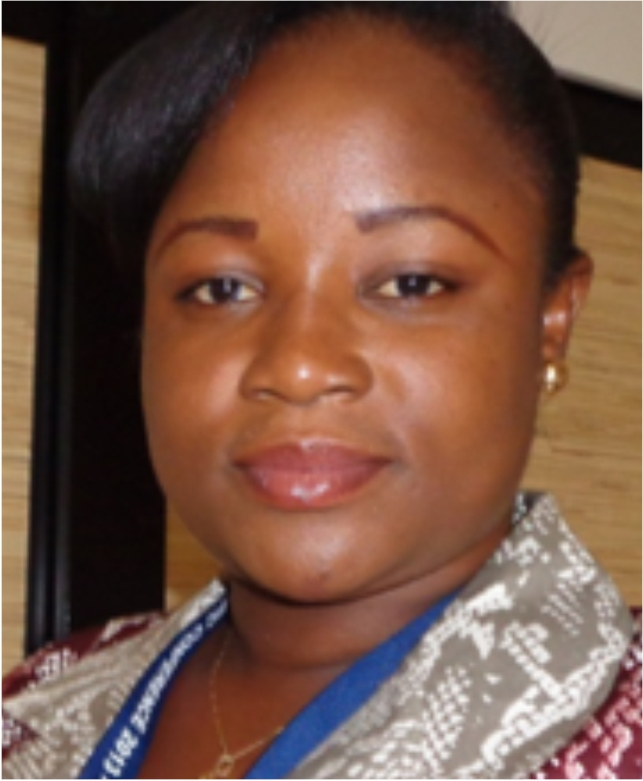
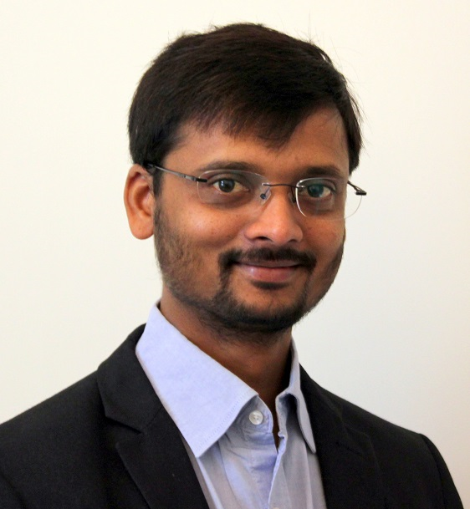
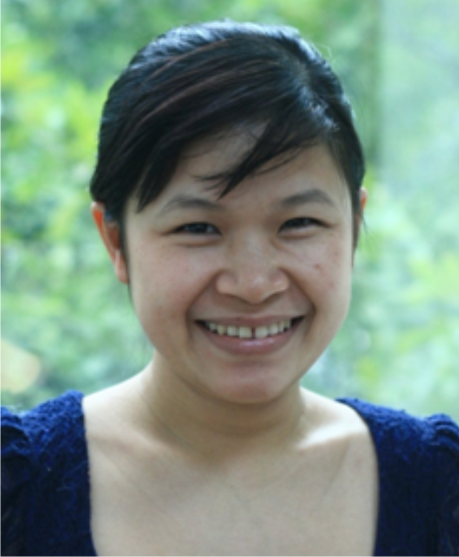
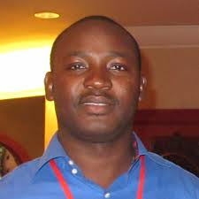
Capacity Strengthening and training
  Masters Training
    51 funded students in all; (None funded in 2016, seven continuing students) – About $2M spent
    PhD training (direct or nested in Working Groups)
    8 Students (Two funded in 2016 & one successful completion)
    Data management support (Training workshops for data managers)
      Three workshops: OpenHDS for 5 centres & Data management for 20+ centres in Dubai and Pune
WE WANT TO BE ABLE TO SUPPORT MORE…
Notes:
How we need to be able to do this long term! The expertise in INDEPTH can be used to establish a training centre and handle some of the courses, contributing to accredited certification

Slide 17
The Lancet, Nature, Science, IJE, BMJ... 2016: counting ...
KEY: multi-centre publications (Working Groups & Projects) Similar trend...
Acknowledging INDEPTH / identifying with INDEPTH AUTHORSHIP ISSUES…

Slide 18
Cause of Death
111,910 Deaths
98,429 Verbal Autopsies
22 Sites
26 Sites
PLOS One recognises INDEPTH
Repository for publication datasets
20 Sites
1600 downloads
800 – Africa
250 – Asia
13 Sites
6 Sites

Slide 19
INDEPTH Analysis of data on INDEPTHStats
Meeting in Kampala – Strategic Group on Data Analysis
Population structure
Fertility
Mortality (morbidity)
Cause of death
Migration
Produce a report on the available data on INDEPTHStats
Do annual updates
SAC: Annual update accompanied by a high-level commentary piece published in a journal
Notes:
But we are cognisant of the challenges and the issues

Slide 20
INDEPTH continues to play a key role in the data sharing debate
INDEPTH publications on data sharing have appeared in
  Lancet, Lancet Global Health, International Journal of Epidemiology, British Medical Journal
Kobus Herbst and Osman Sankoh invited to several international workshops to present INDEPTH’s example
INDEPTH hosted a workshop led by Chatham House in Accra to discuss data sharing (Product: a joint statement)
INDEPTH co-organised a workshop in Cape Town by many funding organisations (Product: an NIH report)
INDEPTH hosted IHME in Accra – Ebola preparedness (Product: a joint paper in Emerg Inf Diseases)
Notes:
But we are cognisant of the challenges and the issues

Slide 21
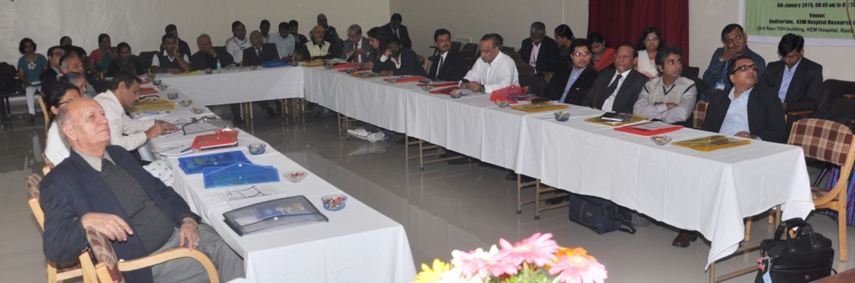
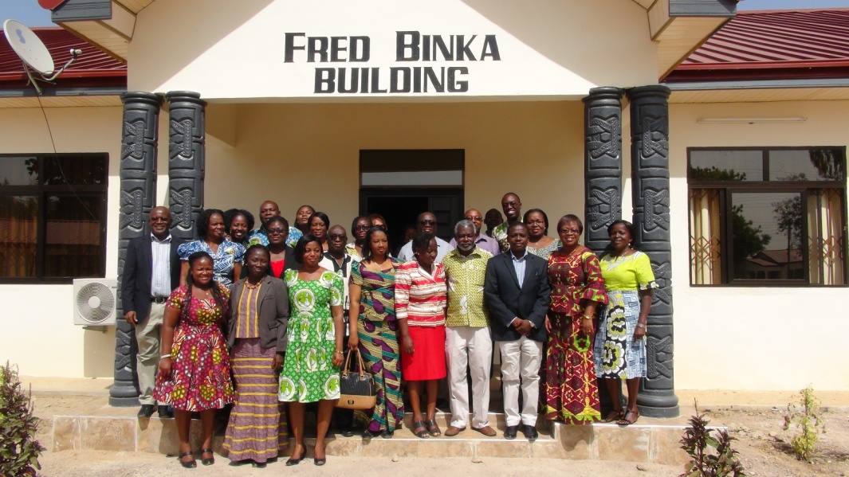
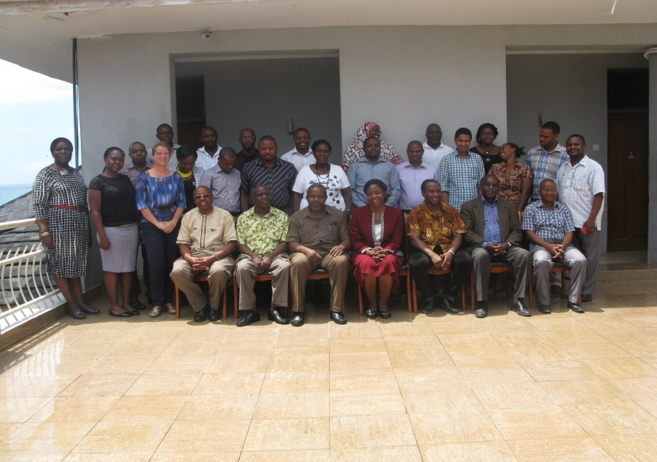
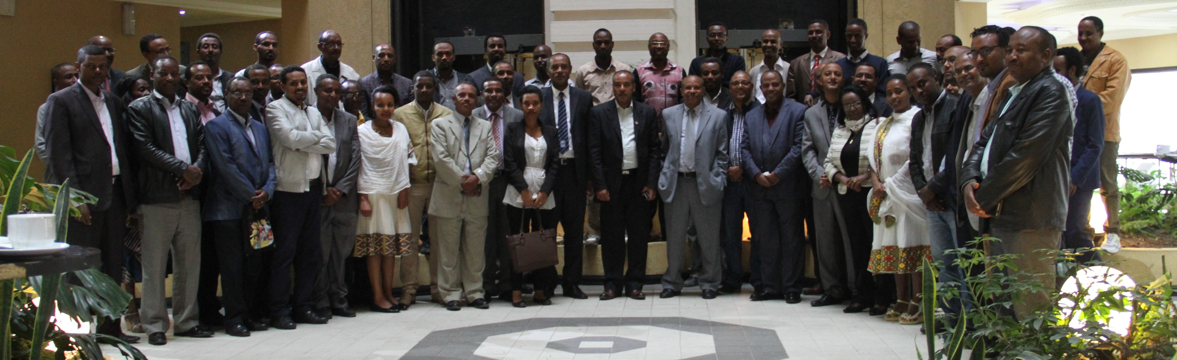
Policy Engagement
Research to Policy Country Meetings
INDIA
GHANA
ETHIOPIA
TANZANIA
Notes:
21
We are now committed to engaging policy makers so that the evidence we generate can be used, and should be seen to be used to guide policy and planning processes

Slide 22
NEW STRATEGIC PLAN
Our Vision
2013-2016 | 2017-2021
INDEPTH will be an international network of HDSS centres that provides data to enable LMICs set health priorities and policies based on the best available evidence, and …. to ensure and monitor progress towards national goals | INDEPTH will be a trusted source for evidence supporting and evaluating progress towards health and development goals

Slide 23
NEW STRATEGIC PLAN
Our Mission
2013-2016 | 2017-2021
To harness the collective potential of the world's community-based longitudinal demographic surveillance initiatives in low and middle income countries to provide a better understanding of health and social issues, and to encourage the application of this understanding to alleviate major health and social problems | To lead a coordinated approach by the world’s health and demographic surveillance systems to provide timely longitudinal evidence across the range of transitioning settings to understand and improve population health and development policy and practice.

Slide 24
NEW STRATEGIC PLAN
Our Strategic Objectives
2013-2016 | 2017-2021
To support and strengthen the ability of INDEPTH member centres to conduct longitudinal health and demographic studies in defined populations. To facilitate the translation of findings to maximise impact on policy and practice. To facilitate and support research capability strengthening | Enhance the INDEPTH Network's capabilities: improve and expand the underlying longitudinal tracking platform Conduct population-based research, leveraging its longitudinal tracking: stimulate, facilitate and conduct cutting-edge multi-centre research Enrich and guide policy that is community responsive and closely linked to the SDGs: INDEPTH will continue to generate evidence and facilitate the translation of INDEPTH findings to enrich and provide evidence on policy, programmes and practice Strengthen capacity of INDEPTH member centres and researchers Build effective partnerships: national and international partners including statistics offices, local government, health and development ministries and agencies, as well as relevant research and educational institutions

Slide 25
Broad Research / Activity Areas
Implement CHESS at all sites to deepen the longitudinal platform to answer new scientific questions : make morbidity surveillance routine
Provide timely metrics based on real data : make the best out of INDEPTHStats
Conduct studies across the life-course: from pregnancy to adult health and ageing; identify relevant practices and interventions
Expand the utility of the platform to generate and analyse SDG indicator baseline & dynamics; conduct safety and effectiveness studies of drugs and vaccines
Assess scientific- and policy-relevant determinants & context of outcomes: Nutrition, diet and food security; Environment, climate, indoor air pollution; Health equity, migration and poverty; Vaccines: safety, effectiveness and efficacy; Sex differentials/gender; Education-based analysis and interventions; Health system assessments
Notes:
25

Slide 26
Capacity Issues 2017-2021
Strengthen the capacities of people and institutions
Expand the INDEPTH Scientific Development and Leadership Programme including the MSc programmes
Notes:
26

Slide 27
Policy Engagement 2017-2021
Tailor, package and direct research outputs for different stakeholders to stimulate public appreciation of findings
Leverage engagement with policy makers to attract more funding for research-into-practice activities
Notes:
27

Slide 28
Ensuring Financial Sustainability 2017-2021
Continue to look for both core and project support from funding partners.
Strengthen the efforts at building an INDEPTH consultancy that leverages the skills and advantage of the Network.
Growing the INDEPTH Endowment Fund
  Construction of an INDEPTH Training Centre
Notes:
28

Slide 29
Some Key Challenges… opportunities
Science:
  Leadership, new cross-site research opportunities / productivity
Capacity:
  Achieving tailored capacity strengthening
Funding
  Core support / Project funding / Network-Centre interests
Policy Engagement and Communications
  Getting the INDEPTH brand
  Engaging with policy makers at various levels

Slide 30

















Our Key Partners

